Slide 1
Spring + hibernate + JPA
2018/10/18

Slide 2
Introduction
Object-relational mapping (ORM)
Mapping object models (Java programs) to relational models (database tables, fields) and vice versa
Java Persistence API (JPA)
a vendor independent specification for ORM
Popular JPA Providers
Hibernate, Toplink, EclipseLink and Apache OpenJPA

Slide 3
History
JPA 1.0 - released in 2006 as a part of EJB 3.0 specification.
JPA 2.0 - released in the last of 2009.
It supports validation.
It expands the functionality of object-relational mapping.
It shares the object of cache support.
JPA 2.1 - released in 2013
It allows fetching of objects.
It provides support for criteria update/delete.
It generates schema.
JPA 2.2 - released as a development of maintainenece in 2017.
It supports Java 8 Date and Time.
It provides @Repeatable annotation that can be used when we want to apply the same annotations to a declaration or type use.
It allows JPA annotation to be used in meta-annotations.
It provides an ability to stream a query result.

Slide 4
EntityManager – A class that manages the persistent state(or lifecycle) of an entity.
Persistence Unit – is a named configuration of entity classes.
Persistence Context – is a managed set of entity instances. The entities classes are part of the Persistence Unit configurations.
Managed Entities – an entity instance is managed if it is part of a persistence context and that Entity Manager can act upon it.

Slide 5
EntityManager in JPA
There are three main types of EntityManagers defined in JPA.
Container Managed and Transaction Scoped Entity Managers
Container Managed and Extended Scope Entity Managers
Application Managed Entity Managers

Slide 6
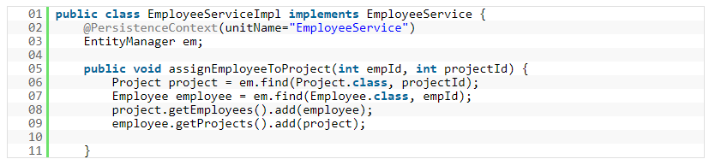
Container Managed Entity Manager
When a container of the application(be it a Java EE container or any other custom container like Spring) manages the lifecycle of the Entity Manager, the Entity Manager is said to be Container Managed.
The most common way of acquiring a Container Managed EntityManager is to use @PersistenceContext annotation on an EntityManager attribute.

Slide 7
Container Managed Entity Managers come in two flavors :
Transaction Scoped Entity Managers
Extended Scope Entity Managers
The biggest benefit of using Transaction Scoped Entity Manager is that it is stateless.
This also makes the Transaction Scoped EntityManager threadsafe and thus virtually maintenance free.
But we just said that an EntityManager manages the persistence state of an entity
and the persistence state of an entity is part of the persistence context that get injected into the EntityManager.
all Container Managed Entity Managers depend on JTA Transactions.
Every time an operation is invoked on an Entity Manager, the container proxy(the container creates a proxy around the entity manager while instantiating it ) checks for any existing Persistence Context on the JTA Transaction.
If it finds one, the Entity Manager will use this Persistence Context. If it doesnt find one, then it will create a new Persistence Context and associates it with the transaction.

Slide 8
In the above example the first line of assignEmployeeToProject method is calling a find method on the EntityManager.
The call to find will force the container to check for an existing transaction.
the container guarantees that a transaction is available whenever a method on the bean is called or not.
If the transaction doesnt exist, it will throw Exception.
If it exists, it will then check whether a Persistence Context exists.
Since its the first call to any method of the EntityManager, a persistence context is not available yet. The Entity Manager will then create one and use it to find the project bean instance.
In the next call to find, the Entity Manager already has an associated Transaction as well as the Persistence Context associated with it.
It uses the same transaction to find employee instance.
By the end of 2nd line in the method both project and employee instance are managed.
At the end of the method call, the transaction is committed and the managed instances of person and employee get persisted.
when the transaction is over, the Persistence Context goes away.

Slide 9
Transaction Management
Transactions are directly related to entities. Managing transactions essentially then would mean managing how entities lifecycle(create, update delete) is managed.
the only role of EntityManager is to determine the lifetime of the Persistence Context.
It plays no role in dictating how a Persistence Context should behave.
Whenever a transaction begins, a Persistence Context instance gets associated with it.
And when a Transaction ends(commits for example), the Persistence Context is flushed and get disassociated with the transaction.

Slide 10
Transaction management types
RESOURCE LOCAL Transactions
Resource local transactions refer to the native transactions of the JDBC Driver
A Resource Local transaction involves a single transactional resource, for example a JDBC Connection.
JTA or GLOBAL Transactions
JTA transactions refer to the transactions of the JEE server.
Whenever you need two or more resources(f or example a JMS Connection and a JDBC Connection) within a single transaction, you use JTA Transaction.
Application Managed Entity Managers can use either Resource Local Transactions or JTA transactions.
Container Managed Entity Managers always use JTA transactions as the container takes care of transaction life cycle management and spawning the transaction across multiple transactional resources.

Slide 11
Normally in JTA or global transaction, a third party transaction monitor enlists the different transactional resources within a transaction, prepares them for a commit and finally commits the transaction.
This process of first preparing the resources for transaction(by doing a dry run) and then committing(or rolling back) is called a 2 phase commit.
XA Protocol
In global transactions, a transaction monitor has to constantly talk to different transactional resources.
XA is a protocol specification that provides a common ground for the transaction monitor to interact with different transactional resources.
JTA is a global transaction monitor specification that speaks XA and thus is able to manage multiple transactional resources.

Slide 12
Persistence Context, Transactions and Entity Managers
A Persistence Context can be associated with either single or multiple transactions and can be associated with multiple Entity Managers.
A Persistence Context gets registered with a transaction so that persistence context can be flushed when a transaction is committed.
When a transaction starts, the Entity Manager looks for an active Persistence Context instance.
If it is not available it creates one and binds it to the transaction.
Normally the scope of the persistence context is tightly associated with the transaction. When a transaction ends, the persistence context instance associated with that transaction also ends.
But sometime, mostly in the Java EE world, we require transaction propagation, which is the process of sharing a single persistence context between different Entity Managers within a single transaction.

Slide 13
Persistence Contexts can have two scopes:
Transaction Scoped Persistence Context
Extended Scoped Persistence Context
A Transactional scoped Entity Manager creates a Transaction scoped Persistence Context.
An Extended Scope Entity Manager uses the Extended Persistence Context.
The lifecycle of the Extended Persistence Context is tied to the Stateful Session Bean in the Java EE environment.

Slide 14
ORM Mapping Directions
Unidirectional relationship
In this relationship, only one entity can refer the properties to another.
It contains only one owing side that specifies how an update can be made in the database.
Bidirectional relationship
This relationship contains an owning side as well as an inverse side.
So here every entity has a relationship field or refer the property to other entity.

Slide 15
Types of Mapping
One-to-one
This association is represented by @OneToOne annotation. Here, instance of each entity is related to a single instance of another entity.
One-to-many
This association is represented by @OneToMany annotation. In this relationship, an instance of one entity can be related to more than one instance of another entity.
Many-to-one
This mapping is defined by @ManyToOne annotation. In this relationship, multiple instances of an entity can be related to single instance of another entity.
Many-to-many
This association is represented by @ManyToMany annotation. Here, multiple instances of an entity can be related to multiple instances of another entity. In this mapping, any side can be the owing side.

Slide 16
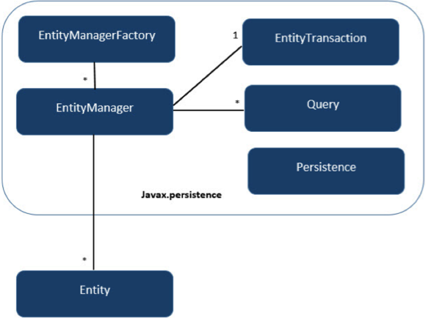
JPA Class Relationship
Units | Description
EntityManagerFactory | This is a factory class of EntityManager. It creates and manages multiple EntityManager instances.
EntityManager | It is an Interface, it manages the persistence operations on objects. It works like factory for Query instance.
Entity | Entities are the persistence objects, stores as records in the database.
EntityTransaction | It has one-to-one relationship with EntityManager. For each EntityManager, operations are maintained by EntityTransaction class.
Persistence | This class contain static methods to obtain EntityManagerFactory instance.
Query | This interface is implemented by each JPA vendor to obtain relational objects that meet the criteria.

Slide 17
Entity Entity Properties
Persistability
An object is called persistent if it is stored in the database and can be accessed anytime.
Persistent Identity
In Java, each entity is unique and represents as an object identity. Similarly, when the object identity is stored in a database then it is represented as persistence identity. This object identity is equivalent to primary key in database.
Transactionality
Entity can perform various operations such as create, delete, update. Each operation makes some changes in the database. It ensures that whatever changes made in the database either be succeed or failed atomically.
Granuality
Entities should not be primitives, primitive wrappers or built-in objects with single dimensional state.

Slide 18
Entity Metadata
Each entity is associated with some metadata that represents the information of it.
Instead of database, this metadata is exist either inside or outside the class.
This metadata can be in following forms:
Annotation - In Java, annotations are the form of tags that represents metadata. This metadata persist inside the class.
XML - In this form, metadata persist outside the class in XML file.

Slide 19
Annotations
Annotation | Description
@Entity | This annotation specifies to declare the class as entity or a table.
@Table | This annotation specifies to declare table name.
@Basic | This annotation specifies non constraint fields explicitly.
@Embedded | This annotation specifies the properties of class or an entity whose value instance of an embeddable class.
@Id | This annotation specifies the property, use for identity (primary key of a table) of the class.
@GeneratedValue | This annotation specifies, how the identity attribute can be initialized such as Automatic, manual, or value taken from sequence table.
@Transient | This annotation specifies the property which in not persistent i.e. the value is never stored into database.
@Column | This annotation is used to specify column or attribute for persistence property.
@SequenceGenerator | This annotation is used to define the value for the property which is specified in @GeneratedValue annotation. It creates a sequence.
@TableGenerator | This annotation is used to specify the value generator for property specified in @GeneratedValue annotation. It creates a table for value generation.

Slide 20
Annotation | Description
@AccessType | This type of annotation is used to set the access type. If you set @AccessType(FIELD) then Field wise access will occur. If you set @AccessType(PROPERTY) then Property wise assess will occur.
@JoinColumn | This annotation is used to specify an entity association or entity collection. This is used in many- to-one and one-to-many associations.
@UniqueConstraint | This annotation is used to specify the field, unique constraint for primary or secondary table.
@ColumnResult | This annotation references the name of a column in the SQL query using select clause.
@ManyToMany | This annotation is used to define a many-to-many relationship between the join Tables.
@ManyToOne | This annotation is used to define a many-to-one relationship between the join Tables.
@OneToMany | This annotation is used to define a one-to-many relationship between the join Tables.
@OneToOne | This annotation is used to define a one-to-one relationship between the join Tables.
@NamedQueries | This annotation is used for specifying list of named queries.
@NamedQuery | This annotation is used for specifying a Query using static name.

Slide 21
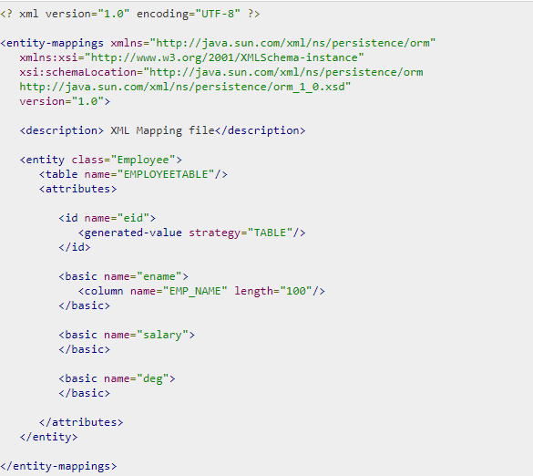
mapping.xml
ex

Slide 22
Java Bean Standard
Bean contains the default constructor or a file that contains serialized instance. Therefore, a bean can instantiate the bean.
Non-Boolean property contains getter and setter methods.
Getter method of any property should start with small lettered ‘get’ (java method convention) and continued with a field name that starts with capital letter. E.g. the field name is ‘salary’ therefore the getter method of this field is ‘getSalary ()’.
Setter method of any property should start with small lettered ‘set’ (java method convention), continued with a field name that starts with capital letter and the argument value to set to field. E.g. the field name is ‘salary’ therefore the setter method of this field is ‘setSalary (double sal)’.
Boolean property contain setter and is method.
For Boolean property, is method to check if it is true or false. E.g. the Boolean property ‘empty’, the is method of this field is ‘isEmpty ()’.

Slide 23
Entity Class
@Entity
@Table(name="PERSON")
public class Person {
@Id
@Column(name="id")
@GeneratedValue(strategy=GenerationType.IDENTITY)
private int id;
private String name;
public int getId() {
return id;
}
public void setId(int id) {
this.id = id;
}
public String getName() {
return name;
}
public void setName(String name) {
this.name = name;
}
@Override
public String toString(){
return "id="+id+", name="+name+", country="+country;
}
}
ex

Slide 24
Entity manager
similar to the Hibernate Session class
entity manager is not expected to be thread safe (don't inject it into a servlet class variable which is visible to multiple threads).

Slide 25
Application-managed entity managers
Application-managed entity managers provide direct access to the underlying persistence provider (org.hibernate.ejb.HibernatePersistence).
The scope of the application-managed entity manager is from when the application creates it and lasts until the app closes it.
Use the @PersistenceUnit annotation to inject a persistence unit into a javax.persistence.EntityManagerFactory.
The EntityManagerFactory can return an application-managed entity manager.

Slide 26
Container-managed entity manager
Container-managed entity managers auto-magically manage the underlying persistence provider for the application.
Container-managed entity managers may use transaction-scoped persistence contexts or extended persistence contexts.
The container-managed entity manager will create instances of the underlying persistence provider as needed.
Every time that a new underlying persistence provider (org.hibernate.ejb.HibernatePersistence) instance is created, a new persistence context is also created (as an implementation detail of the underlying persistence provider).

Slide 27
Persistence Context
The JPA persistence context contains the entities managed by the persistence provider.
The persistence context acts like a first level (transactional) cache for interacting with the datasource.
Loaded entities are placed into the persistence context before being returned to the application.
Entities changes are also placed into the persistence context (to be saved in the database when the transaction commits).

Slide 28
Transaction-scoped Persistence Context
The transaction-scoped persistence context coordinates with the (active) JTA transaction.
When the transaction commits, the persistence context is flushed to the datasource (entity objects are detached but may still be referenced by application code).
All entity changes that are expected to be saved to the datasource, must be made during a transaction.
Entities read outside of a transaction will be detached when the entity manager invocation completes.

Slide 29
Extended Persistence Context
The (ee container managed) extended persistence context can span multiple transactions and allows data modifications to be queued up (like a shopping cart), without an active JTA transaction (to be applied during the next JTA TX).
The Container-managed extended persistence context can only be injected into a stateful session bean.

Slide 30
Entities - lifecycle
New (transient):
an entity is new if it has just been instantiated using the new operator, and it is not associated with a persistence context.
It has no persistent representation in the database and no identifier value has been assigned.
Managed (persistent):
a managed entity instance is an instance with a persistent identity that is currently associated with a persistence context.
Detached:
the entity instance is an instance with a persistent identity that is no longer associated with a persistence context, usually because the persistence context was closed or the instance was evicted from the context.
Removed:
a removed entity instance is an instance with a persistent identity, associated with a persistence context, but scheduled for removal from the database.

Slide 31
persistence.xml
a standard configuration file
has to be included in the META-INF directory inside the JAR file that contains the entity beans.
define a persistence-unit with a unique name in the current scoped classloader.
The provider attribute specifies the underlying implementation of the JPA EntityManager.

Slide 32
JPA basic program example
EntityManagerFactory emFactory = Persistence.createEntityManagerFactory( "LOCAL_PERSISTENCE" );
EntityManager entityManager = emFactory.createEntityManager( );
entityManager.getTransaction( ).begin( );
Person person = new Person();
person.setName("Elvin");
person.setCountry("Denmark");
entityManager.persist(person);
System.out.println("create: " + person.toString());
entityManager.getTransaction().commit();
entityManager.close();
emFactory.close();

Slide 33
Java Persistence Query language
JPQL syntax is very similar to the syntax of SQL.
SQL works directly against relational database tables, records and fields, whereas JPQL works with Java classes and instances.

Slide 34
EntityManagerFactory emFactory = Persistence.createEntityManagerFactory( "LOCAL_PERSISTENCE" );
EntityManager entityManager = emFactory.createEntityManager( );
entityManager.getTransaction( ).begin( );
Query query = entityManager.createQuery("from Person p");
List<Person> personList = query.getResultList();
for (Person item: personList) {
System.out.println("list: " + item.toString());
}
entityManager.getTransaction().commit();
entityManager.close();
emFactory.close();

Slide 35
Basic
from Person p
select p from Person p
Between, And, Like Keywords
Select e from Employee e where e.salary Between 30000 and 40000
Select e from Employee e where e.ename LIKE 'M%'
Ordering
Select e from Employee e ORDER BY e.ename ASC

Slide 36
Named Queries
A @NamedQuery annotation is defined as a query with a predefined unchangeable query string.
Instead of dynamic queries, usage of named queries may improve code organization by separating the JPQL query strings from POJO.
It also passes the query parameters rather than embedding literals dynamically into the query string and results in more efficient queries.

Slide 37
Eager and Lazy Loading
The main concept of JPA is to make a duplicate copy of the database in cache memory. While transacting with the database, first it will effect on duplicate data and only when it is committed using entity manager, the changes are effected into the database.
Eager fetch
Fetching the whole record while finding the record using Primary Key.
Lazy fetch
It checks for the availability of entities with primary key if it exists. Then later if you call any of the getter method of that entity then it fetches the whole.
The default depends on the cardinality of the relationship.
All to-one relationships use FetchType.EAGER by default
all to-many relationships FetchType.LAZY by default

Slide 38
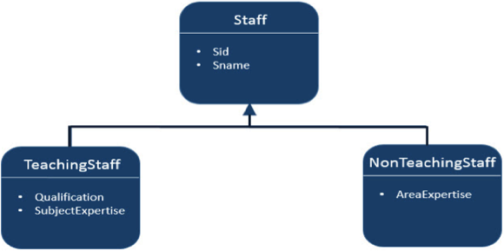
Inheritance Strategies
JPA support three types of inheritance strategies such as SINGLE_TABLE, JOINED_TABLE, and TABLE_PER_CONCRETE_CLASS.

Slide 39
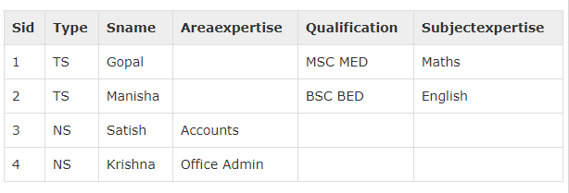
Single Table strategy
@Id @GeneratedValue( strategy = GenerationType.AUTO )
Single-Table strategy takes all classes fields (both super and sub classes) and map them down into a single table known as SINGLE_TABLE strategy.
Here discriminator value plays key role in differentiating the values of three entities in one table.
Finally you will get single table which contains all three class’s fields and differs with discriminator column named ‘Type’ (field)

Slide 40
private int sid; private String sname;
@Entity
@Table
@Inheritance( strategy = InheritanceType.SINGLE_TABLE )
@DiscriminatorColumn( name = "type" )
public class Staff implements Serializable {
@Id
@GeneratedValue( strategy = GenerationType.AUTO )
private int sid;
private String sname;
@Entity
@DiscriminatorValue( value="TS" )
public class TeachingStaff extends Staff {
private String qualification;
private String subjectexpertise;
@Entity
@DiscriminatorValue( value = "NS" )
public class NonTeachingStaff extends Staff {
private String areaexpertise;

Slide 41
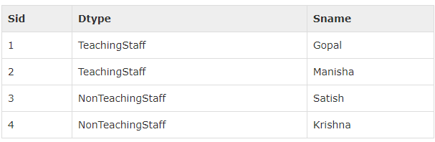
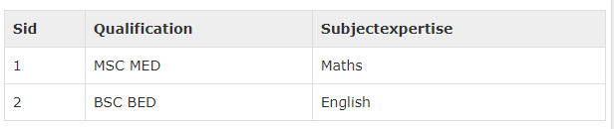
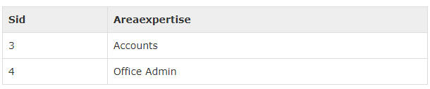
Joined table Strategy
Joined table strategy is to share the referenced column which contains unique values to join the table and make easy transactions.
Here three tables are created: Staff, TeachingStaff, NonTeachingStaff

Slide 42
@Entity
@Table
@Inheritance( strategy = InheritanceType.JOINED )
public class Staff implements Serializable {
@Id
@GeneratedValue( strategy = GenerationType.AUTO )
private int sid;
private String sname;
@Entity
@PrimaryKeyJoinColumn(referencedColumnName="sid")
public class TeachingStaff extends Staff {
private String qualification;
private String subjectexpertise;
@Entity
@PrimaryKeyJoinColumn(referencedColumnName="sid")
public class NonTeachingStaff extends Staff {
private String areaexpertise;

Slide 43

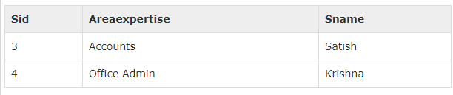
Table per class strategy
Table per class strategy is to create a table for each sub entity.
The staff table will be created but it will contain null records.
The field values of Staff table must be shared by TeachingStaff and NonTeachingStaff tables.
Here the three tables are created
Staff table contains null records.
TeachingStaff, NonTeachingStaff

Slide 44
@Entity
@Table
@Inheritance( strategy = InheritanceType.TABLE_PER_CLASS )
public class Staff implements Serializable {
@Id
@GeneratedValue( strategy = GenerationType.AUTO )
private int sid;
private String sname;
@Entity
public class TeachingStaff extends Staff {
private String qualification;
private String subjectexpertise;
@Entity
public class NonTeachingStaff extends Staff {
private String areaexpertise;

Slide 45
relationships between Entities
@ManyToOne Relation
@OneToMany Relation
@OneToOne Relation
@ManyToMany Relation

Slide 46
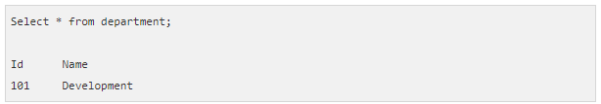
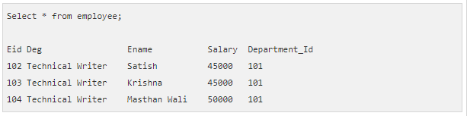
@ManyToOne Relation
Many-To-One relation between entities:
Where one entity (column or set of columns) is/are referenced with another entity (column or set of columns) which contain unique values.
In relational databases these relations are applicable by using foreign key/primary key between tables.

Slide 47
@Entity
public class Employee{
@Id
@GeneratedValue( strategy= GenerationType.AUTO )
private int eid;
private String ename;
private double salary;
private String deg;
@ManyToOne
private Department department;
@Entity
public class Department {
@Id
@GeneratedValue( strategy=GenerationType.AUTO )
private int id;
private String name;

Slide 48
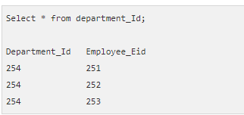
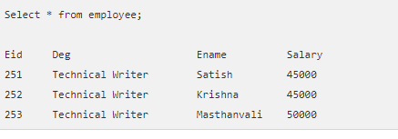
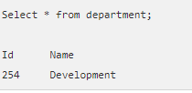
@OneToMany Relation
In this relationship each row of one entity is referenced to many child records in other entity.
The important thing is that child records cannot have multiple parents.

Slide 49
@Entity
public class Employee {
@Id
@GeneratedValue( strategy= GenerationType.AUTO )
private int eid;
private String ename;
private double salary;
private String deg;
@Entity
public class Department {
@Id
@GeneratedValue( strategy=GenerationType.AUTO )
private int id;
private String name;
@OneToMany( targetEntity=Employee.class )
private List employeelist;

Slide 50
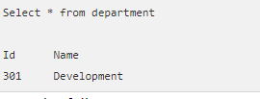
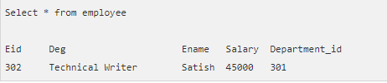
@OneToOne Relation
In One-To-One relationship, one item can belong to only one other item.
It means each row of one entity is referred to one and only one row of another entity.

Slide 51
@Entity
public class Employee {
@Id
@GeneratedValue( strategy= GenerationType.AUTO )
private int eid;
private String ename;
private double salary;
private String deg;
@OneToOne
private Department department;
@Entity
public class Department {
@Id
@GeneratedValue( strategy=GenerationType.AUTO )
private int id;
private String name;

Slide 52
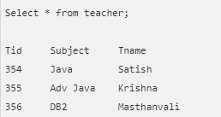
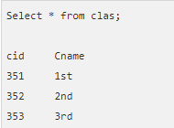
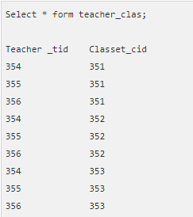
@ManyToMany Relation
Many-To-Many relationship is where one or more rows from one entity are associated with more than one row in other entity.

Slide 53
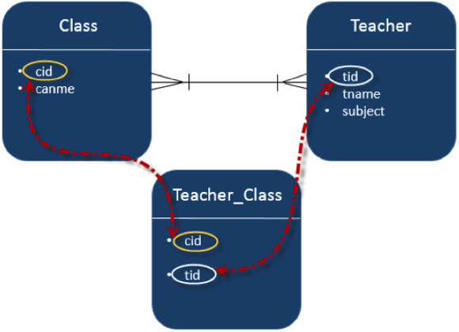
@Entity
public class Clas {
@Id
@GeneratedValue( strategy = GenerationType.AUTO )
private int cid;
private String cname;
@ManyToMany(targetEntity=Teacher.class)
private Set teacherSet;
@Entity
public class Teacher {
@Id
@GeneratedValue( strategy = GenerationType.AUTO )
private int tid;
private String tname;
private String subject;
@ManyToMany(targetEntity = Clas.class)
private Set clasSet;

Slide 54
Criteria API
The Criteria API is a predefined API used to define queries for entities.
It is the alternative way of defining a JPQL query.
These queries are type-safe, and portable and easy to modify by changing the syntax.
Similar to JPQL it follows abstract schema (easy to edit schema) and embedded objects.
The metadata API is mingled with criteria API to model persistent entity for criteria queries.
The major advantage of the criteria API
is that errors can be detected earlier during compile time.
String based JPQL queries and JPA criteria based queries are same in performance and efficiency.

Slide 55
JPA defines a persistence unit through the META-INF/persistence.xml file.
Starting with Spring 3.1, the persistence.xml is no longer necessary – the LocalContainerEntityManagerFactoryBean now supports a ‘packagesToScan’ property where the packages to scan for @Entity classes can be specified.

Slide 56
Criteria Query Structure
EntityManager em = ...;
CriteriaBuilder cb = em.getCriteriaBuilder();
CriteriaQuery<Entity class> cq = cb.createQuery(Entity.class);
Root<Entity> from = cq.from(Entity.class);
cq.select(Entity);
TypedQuery<Entity> q = em.createQuery(cq);
List<Entity> allitems = q.getResultList();
EntityManager instance is used to create a CriteriaBuilder object.
CriteriaQuery instance is used to create a query object. This query object’s attributes will be modified with the details of the query.
CriteriaQuery.from method is called to set the query root.
CriteriaQuery.select is called to set the result list type.
TypedQuery<T> instance is used to prepare a query for execution and specifying the type of the query result.
getResultList method on the TypedQuery<T> object to execute a query. This query returns a collection of entities, the result is stored in a List.

Slide 58
Enviorment
Java 8
tomcat 7.x
spring 4.3
hibernate 4.3 + jpa 2.1
postgresql 8.4

Slide 59
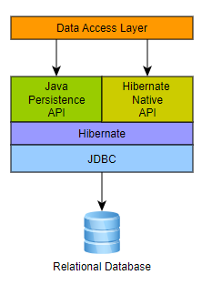
Hibernate ORM
Supported JPA Versions
JPA 1.0: ORM 3.2+
JPA 2.0: ORM 3.5+
JPA 2.1: ORM 4.3+
JPA 2.2: ORM 5.3+

Slide 60
Native SQL Queries
List<Object[]> persons = entityManager.createNativeQuery(
“SELECT * FROM Person" )
.getResultList();
for(Object[] person : persons) {
Number id = (Number) person[0];
String name = (String) person[1];
}
These will return a List of Object arrays ( Object[] ) with scalar values for each column in the PERSON table.
Hibernate will use java.sql.ResultSetMetadata to deduce the actual order and types of the returned scalar values.

Slide 61
List<Object[]> persons = session.createNativeQuery( "SELECT * FROM Person" )
.addScalar( "id", LongType.INSTANCE )
.addScalar( "name", StringType.INSTANCE )
.list();
for(Object[] person : persons) {
Long id = (Long) person[0];
String name = (String) person[1];
}
To avoid the overhead of using ResultSetMetadata, or simply to be more explicit in what is returned, one can use addScalar():

Slide 62
the following query will also return a List where each element is a Person entity.
List<Person> persons = entityManager.createNativeQuery(
“SELECT * FROM Person", Person.class )
.getResultList();

Slide 63
Dao

Slide 64
Boundary
Service
Interface
Dao
Interface
Entity
ServiceImpl
DaoImpl

Slide 65
with persistence.xml

Slide 66
Persistence.xml
<persistence xmlns="http://xmlns.jcp.org/xml/ns/persistence"
xmlns:xsi="http://www.w3.org/2001/XMLSchema-instance"
xsi:schemaLocation="http://xmlns.jcp.org/xml/ns/persistence
http://xmlns.jcp.org/xml/ns/persistence/persistence_2_1.xsd"
version="2.1">
<persistence-unit name="LOCAL_PERSISTENCE">
<description> Spring Hibernate JPA Configuration Example</description>
<provider>org.hibernate.jpa.HibernatePersistenceProvider</provider>
<!-- jdbc configuration -->
<properties>
<property name="javax.persistence.jdbc.driver" value="org.postgresql.Driver" />
<property name="javax.persistence.jdbc.url" value="jdbc:postgresql://localhost:5432/test_db" />
<property name="javax.persistence.jdbc.user" value="test_user" />
<property name="javax.persistence.jdbc.password" value="test_password" />
<property name="hibernate.dialect" value="org.hibernate.dialect.PostgreSQLDialect" />
<property name="hibernate.show_sql" value="true" />
</properties>
</persistence-unit>
</persistence>

Slide 67
spring configuration
add
<bean id="entityManagerFactory" class="org.springframework.orm.jpa.LocalContainerEntityManagerFactoryBean">
<property name="persistenceUnitName" value="LOCAL_PERSISTENCE"/>
</bean>

Slide 68
Dao
add @Repository
@Repository
public class PersonDAOImpl implements PersonDAO {
private static final Logger logger = LoggerFactory.getLogger(PersonDAOImpl.class);
@PersistenceContext
EntityManager entityManager;

Slide 70
without persistence.xml

Slide 71
Spring configuration example
Spring configuration
<bean id="entityManagerFactory" class="org.springframework.orm.jpa.LocalContainerEntityManagerFactoryBean">
<property name="dataSource" ref="dataSource" />
<property name="packagesToScan" value=“my.test.model" />
<property name="jpaVendorAdapter">
<bean class="org.springframework.orm.jpa.vendor.HibernateJpaVendorAdapter" />
</property>
<property name="jpaProperties">
<props>
<prop key="hibernate.dialect">org.hibernate.dialect.PostgreSQLDialect</prop>
<prop key="hibernate.show_sql">true</prop>
</props>
</property>
</bean>
<bean id="dataSource" class="org.apache.commons.dbcp2.BasicDataSource" destroy-method="close">
<property name="driverClassName" value="org.postgresql.Driver" />
<property name="url" value="jdbc:postgresql://localhost:5432/test_db" />
<property name="username" value="test_user" />
<property name="password" value="test_password" />
</bean>

Slide 73
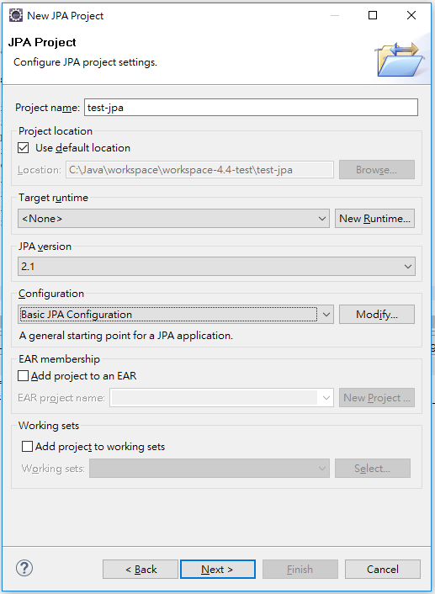
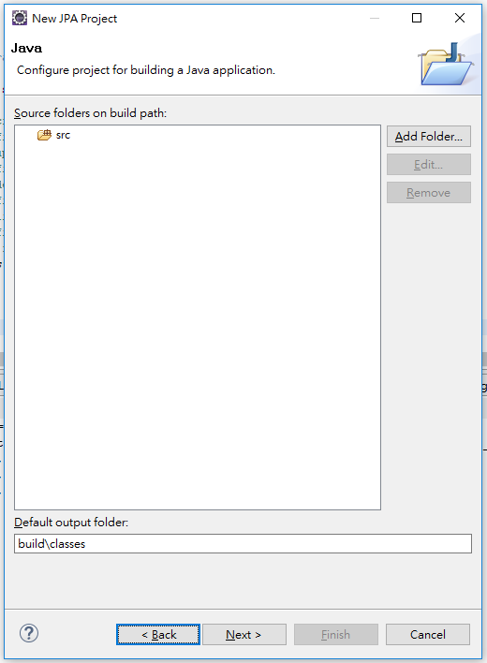
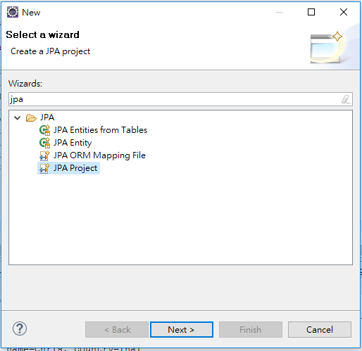
eclipse JPA Project

Slide 74
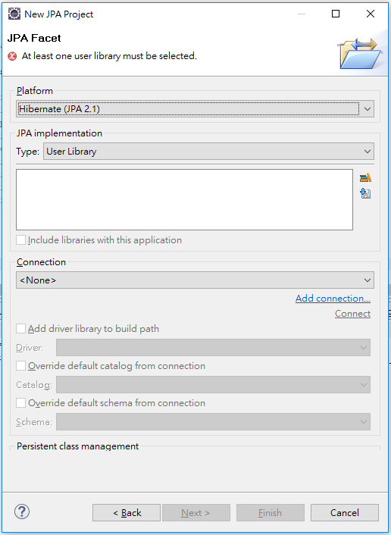
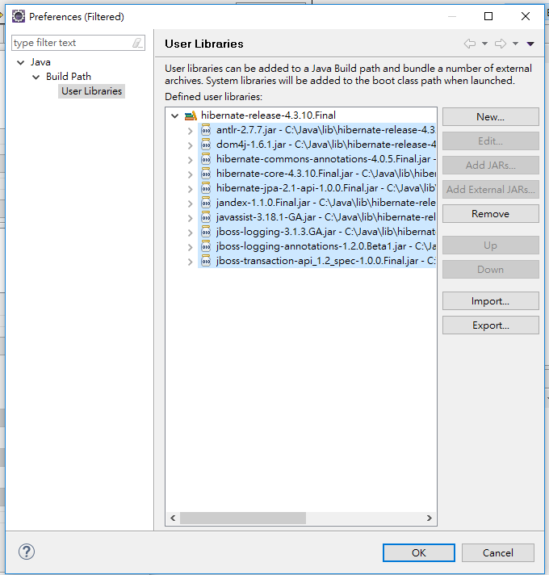

Slide 75
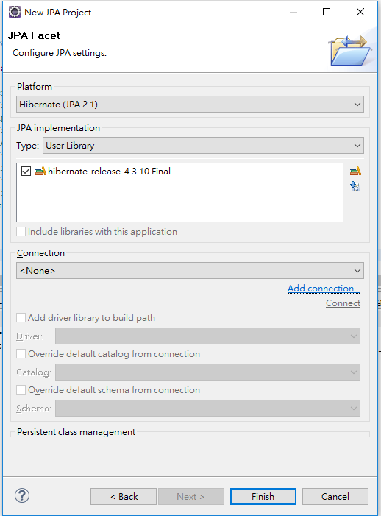
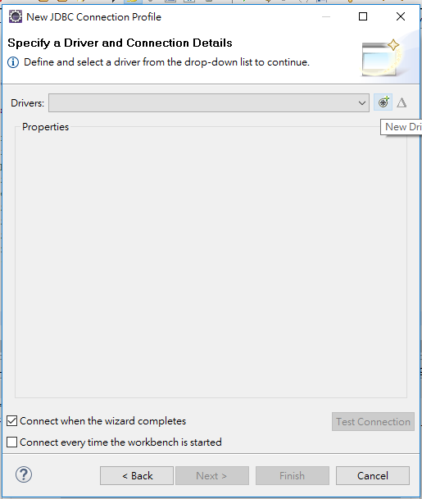
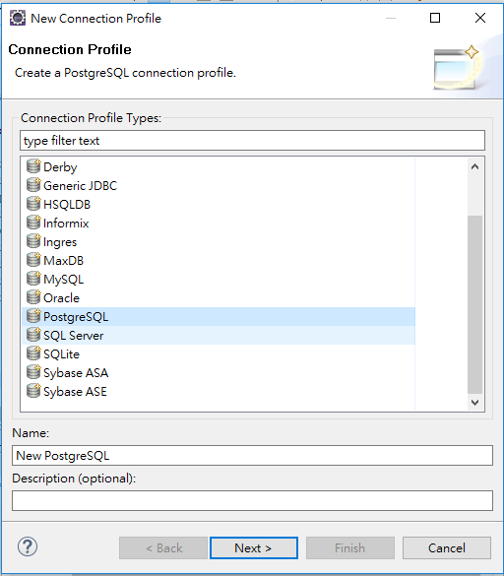

Slide 76
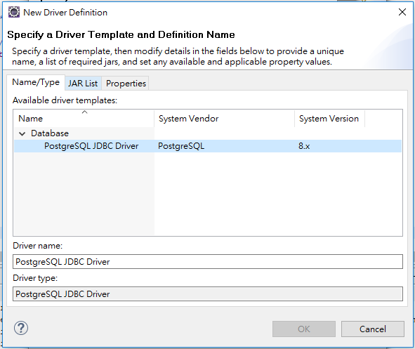
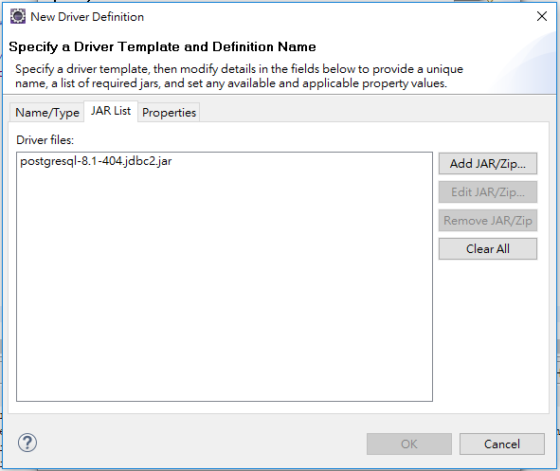
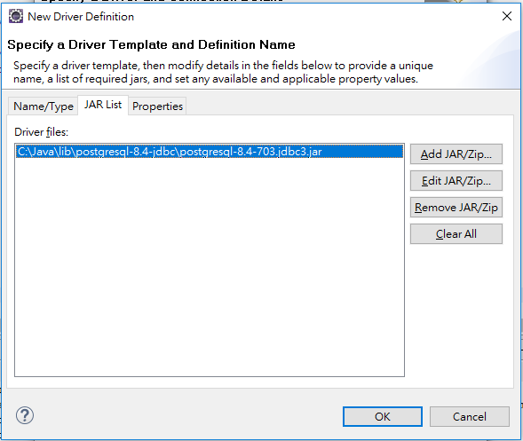

Slide 77
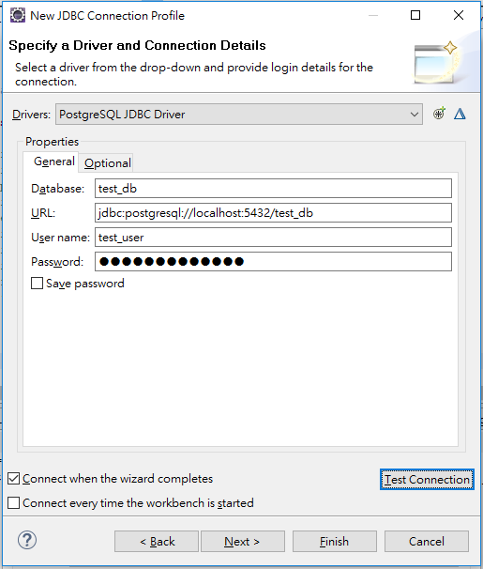
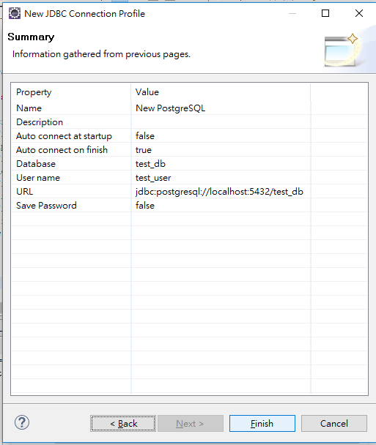

Slide 78
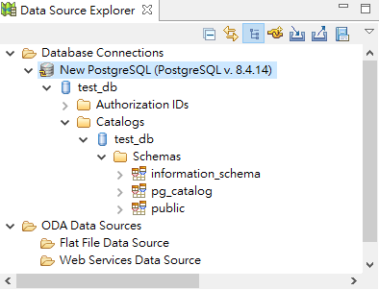
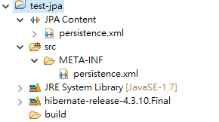

Slide 79
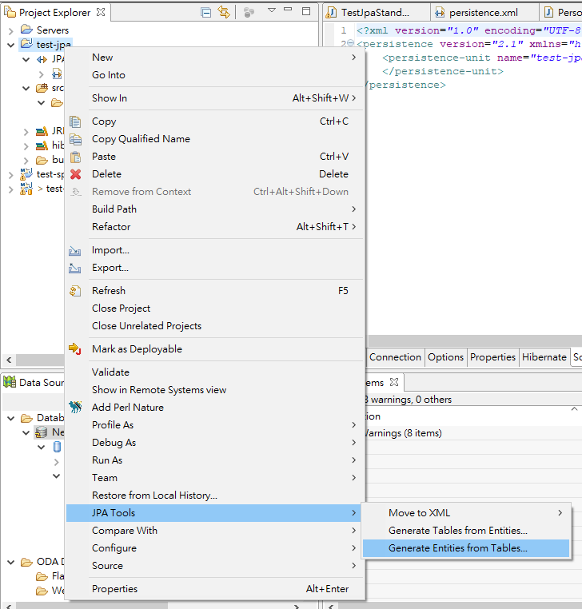
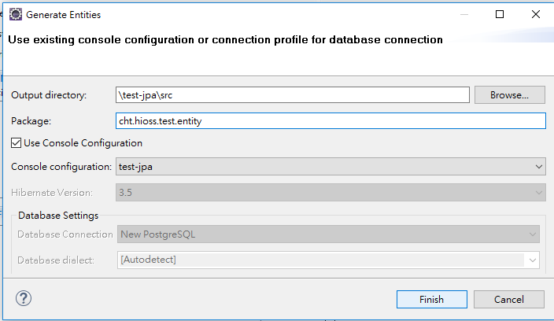

Slide 80
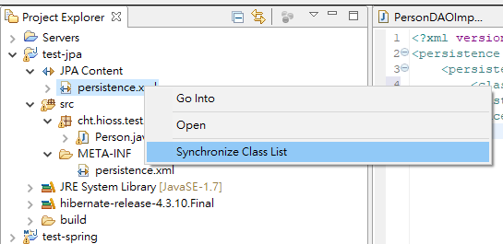
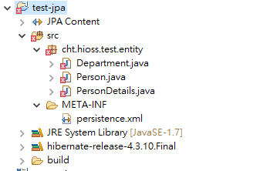

Slide 81
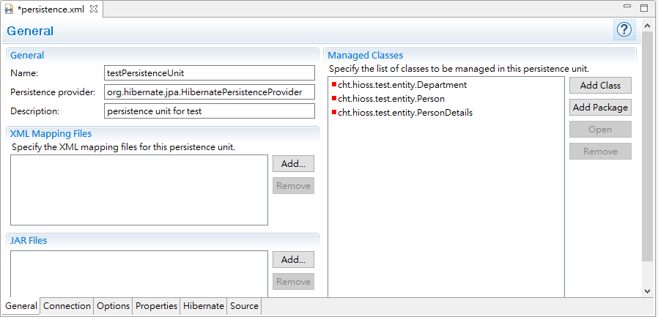
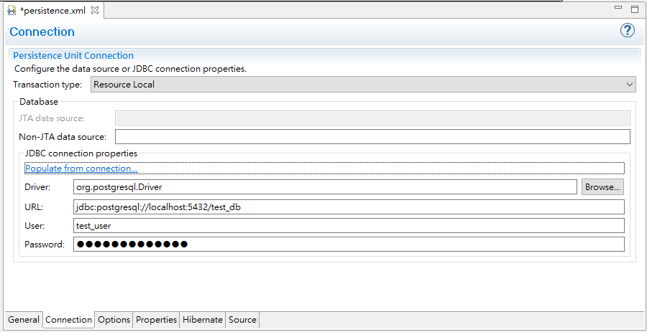

Slide 82
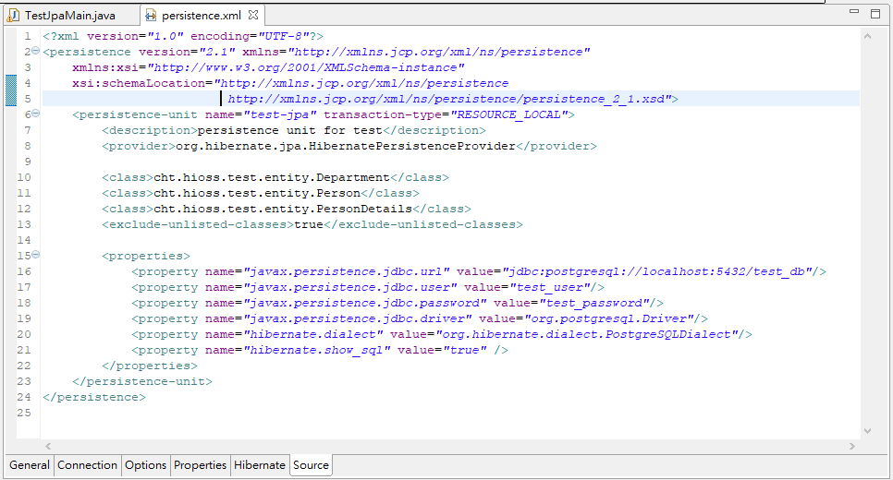

Slide 84
Transaction Management in Spring Framework

Slide 85
Introduction
Consistent programming model across different transaction APIs such as Java Transaction API (JTA), JDBC, Hibernate, Java Persistence API (JPA), and Java Data Objects (JDO).
Support for declarative transaction management.
Simpler API for programmatic transaction management than complex transaction APIs such as JTA.
Excellent integration with Spring’s data access abstractions.

Slide 86
17.2 Advantages of the Spring Framework’s transaction support model
Global transactions
enable you to work with multiple transactional resources, typically relational databases and message queues.
manages global transactions through the JTA,
Furthermore, a JTA UserTransaction normally needs to be sourced from JNDI,
JTA is normally only available in an application server environment.
the preferred way to use global transactions was via EJB CMT (Container Managed Transaction):
CMT is a form of declarative transaction management
CMT is tied to JTA and an application server environment.
Also, it is only available if one chooses to implement business logic in EJBs, or at least behind a transactional EJB facade.

Slide 87
17.2.2 Local transactions
Local transactions are resource-specific, such as a transaction associated with a JDBC connection.
have significant disadvantages:
they cannot work across multiple transactional resources.
Another downside is that local transactions are invasive to the programming model.

Slide 88
17.2.3 Spring Framework’s consistent programming model
Spring resolves the disadvantages of global and local transactions. It enables application developers to use a consistent programming model in any environment.
The Spring Framework provides both declarative and programmatic transaction management.
With programmatic transaction management, developers work with the Spring Framework transaction abstraction, which can run over any underlying transaction infrastructure.
With the preferred declarative model, developers typically write little or no code related to transaction management, and hence do not depend on the Spring Framework transaction API, or any other transaction API.

Slide 89

17.3 Understanding the Spring Framework transaction abstraction
The key to the Spring transaction abstraction is the notion of a transaction strategy.
defined by the org.springframework.transaction.PlatformTransactionManager interface:
This is primarily a service provider interface (SPI), although it can be used programmatically from your application code.
Because PlatformTransactionManager is an interface, it can be easily mocked or stubbed as necessary. It is not tied to a lookup strategy such as JNDI.
This benefit alone makes Spring Framework transactions a worthwhile abstraction even when you work with JTA. Transactional code can be tested much more easily than if it used JTA directly.
public interface PlatformTransactionManager {
TransactionStatus getTransaction(TransactionDefinition definition) throws TransactionException;
void commit(TransactionStatus status) throws TransactionException;
void rollback(TransactionStatus status) throws TransactionException;
}

Slide 90
the TransactionException that can be thrown by any of the PlatformTransactionManager interface’s methods is unchecked (that is, it extends the java.lang.RuntimeException class).
the application developer can choose to catch and handle TransactionException.
The salient point is that developers are not forced to do so.

Slide 91
The getTransaction(..) method returns a TransactionStatus object, depending on a TransactionDefinition parameter.
The returned TransactionStatus might represent a new transaction, or can represent an existing transaction if a matching transaction exists in the current call stack.
The implication in this latter case is that, as with Java EE transaction contexts, a TransactionStatus is associated with a thread of execution.

Slide 92
The TransactionDefinition interface specifies:
Propagation:
Typically, all code executed within a transaction scope will run in that transaction.
However, you have the option of specifying the behavior in the event that a transactional method is executed when a transaction context already exists.
For example, code can continue running in the existing transaction (the common case);
or the existing transaction can be suspended and a new transaction created.
Isolation:
The degree to which this transaction is isolated from the work of other transactions.
For example, can this transaction see uncommitted writes from other transactions?
Timeout:
How long this transaction runs before timing out and being rolled back automatically by the underlying transaction infrastructure.
Read-only status:
A read-only transaction can be used when your code reads but does not modify data.
Read-only transactions can be a useful optimization in some cases, such as when you are using Hibernate.

Slide 93
PlatformTransactionManager implementations normally require knowledge of the environment in which they work: JDBC, JTA, Hibernate, and so on.
The following examples show how you can define a local PlatformTransactionManager implementation. (This example works with plain JDBC.)

Slide 94
You define a JDBC DataSource
The related PlatformTransactionManager bean definition will then have a reference to the DataSource definition.
<bean id="dataSource" class="org.apache.commons.dbcp.BasicDataSource" destroy-method="close">
<property name="driverClassName" value="${jdbc.driverClassName}" />
<property name="url" value="${jdbc.url}" />
<property name="username" value="${jdbc.username}" />
<property name="password" value="${jdbc.password}" />
</bean>
<bean id="txManager" class="org.springframework.jdbc.datasource.DataSourceTransactionManager">
<property name="dataSource" ref="dataSource"/>
</bean>

Slide 95
If you use JTA in a Java EE container then you use a container DataSource, obtained through JNDI, in conjunction with Spring’s JtaTransactionManager. This is what the JTA and JNDI lookup version would look like:
<?xml version="1.0" encoding="UTF-8"?>
<beans xmlns="http://www.springframework.org/schema/beans"
xmlns:xsi="http://www.w3.org/2001/XMLSchema-instance"
xmlns:jee="http://www.springframework.org/schema/jee"
xsi:schemaLocation=" http://www.springframework.org/schema/beans
http://www.springframework.org/schema/beans/spring-beans.xsd
http://www.springframework.org/schema/jee
http://www.springframework.org/schema/jee/spring-jee.xsd">
<jee:jndi-lookup id="dataSource" jndi-name="jdbc/jpetstore"/>
<bean id="txManager" class="org.springframework.transaction.jta.JtaTransactionManager" />
<!-- other <bean/> definitions here -->
</beans>

Slide 96
You can also use Hibernate local transactions easily, as shown in the following examples. In this case, you need to define a Hibernate LocalSessionFactoryBean, which your application code will use to obtain Hibernate Session instances.
<bean id="sessionFactory" class="org.springframework.orm.hibernate5.LocalSessionFactoryBean">
<property name="dataSource" ref="dataSource"/>
<property name="mappingResources">
<list>
<value>org/springframework/samples/petclinic/hibernate/petclinic.hbm.xml</value>
</list>
</property>
<property name="hibernateProperties">
<value> hibernate.dialect=${hibernate.dialect} </value>
</property>
</bean>
<bean id="txManager" class="org.springframework.orm.hibernate5.HibernateTransactionManager">
<property name="sessionFactory" ref="sessionFactory"/>
</bean>

Slide 97
If you are using Hibernate and Java EE container-managed JTA transactions, then you should simply use the same JtaTransactionManager as in the previous JTA example for JDBC.
<bean id="txManager" class="org.springframework.transaction.jta.JtaTransactionManager"/>

Slide 98
17.5 Declarative transaction management
The Spring Framework’s declarative transaction management is made possible with Spring aspect-oriented programming (AOP)
similar to EJB CMT in that you can specify transaction behavior (or lack of it) down to individual method level. It is possible to make a setRollbackOnly() call within a transaction context if necessary.
Unlike EJB CMT, which is tied to JTA, the Spring Framework’s declarative transaction management works in any environment.
It can work with JTA transactions or local transactions using JDBC, JPA, Hibernate or JDO by simply adjusting the configuration files.
You can apply the Spring Framework declarative transaction management to any class, not merely special classes such as EJBs.
The Spring Framework offers declarative rollback rules
The Spring Framework enables you to customize transactional behavior, by using AOP.
For example, you can insert custom behavior in the case of transaction rollback. You can also add arbitrary advice, along with the transactional advice. With EJB CMT, you cannot influence the container’s transaction management except with setRollbackOnly().
The Spring Framework does not support propagation of transaction contexts across remote calls, as do high-end application servers.
If you need this feature, we recommend that you use EJB.

Slide 99
The concept of rollback rules is important:
they enable you to specify which exceptions (and throwables) should cause automatic rollback.
You specify this declaratively, in configuration, not in Java code.
So, although you can still call setRollbackOnly() on the TransactionStatus object to roll back the current transaction back, most often you can specify a rule that MyApplicationException must always result in rollback.
the Spring default behavior:
roll back is automatic only on unchecked exceptions

Slide 100
17.5.1 Understanding the Spring Framework’s declarative transaction implementation
The most important concepts to grasp with regard to the Spring Framework’s declarative transaction support
this support is enabled via AOP proxies,
and that the transactional advice is driven by metadata (currently XML- or annotation-based).
The combination of AOP with transactional metadata yields an AOP proxy that uses a TransactionInterceptor in conjunction with an appropriate PlatformTransactionManager implementation to drive transactions around method invocations.

Slide 101
17.5.2 Example of declarative transaction implementation
<!-- this is the service object that we want to make transactional -->
<bean id="fooService" class="x.y.service.DefaultFooService"/>
<!-- the transactional advice (what 'happens'; see the <aop:advisor/> bean below) -->
<tx:advice id="txAdvice" transaction-manager="txManager">
<!-- the transactional semantics... -->
<tx:attributes>
<!-- all methods starting with 'get' are read-only -->
<tx:method name="get*" read-only="true"/>
<!-- other methods use the default transaction settings (see below) -->
<tx:method name="*"/>
</tx:attributes>
</tx:advice>
<!-- ensure that the above transactional advice runs for any execution
of an operation defined by the FooService interface -->
<aop:config>
<aop:pointcut id="fooServiceOperation" expression="execution(* x.y.service.FooService.*(..))"/>
<aop:advisor advice-ref="txAdvice" pointcut-ref="fooServiceOperation"/>
</aop:config>

Slide 102
17.5.3 Rolling back a declarative transaction
The recommended way to indicate to the Spring Framework’s transaction infrastructure that a transaction’s work is to be rolled back is
to throw an Exception from code that is currently executing in the context of a transaction.
In its default configuration, the Spring Framework’s transaction infrastructure code only marks a transaction for rollback in the case of runtime, unchecked exceptions;
when the thrown exception is an instance or subclass of RuntimeException. ( Errors will also - by default - result in a rollback).
Checked exceptions that are thrown from a transactional method do not result in rollback in the default configuration

Slide 103
in the case of the following configuration, any exception other than an InstrumentNotFoundException results in a rollback of the attendant transaction.
<tx:advice id="txAdvice">
<tx:attributes>
<tx:method name="*" rollback-for="Throwable" no-rollback-for="InstrumentNotFoundException"/>
</tx:attributes>
</tx:advice>

Slide 104
You can also indicate a required rollback programmatically.
public void resolvePosition() {
try {
// some business logic...
}
catch (NoProductInStockException ex) {
// trigger rollback programmatically
TransactionAspectSupport.currentTransactionStatus().setRollbackOnly();
}
}

Slide 105
17.5.5 <tx:advice/> settings
The default <tx:advice/> settings are:
Propagation setting is REQUIRED.
Isolation level is DEFAULT.
Transaction is read/write.
Transaction timeout defaults to the default timeout of the underlying transaction system, or none if timeouts are not supported.
Any RuntimeException triggers rollback, and any checked Exception does not.

Slide 106
Attribute | Required? | Default | Description
name | Yes |  | Method name(s) with which the transaction attributes are to be associated. The wildcard (*) character can be used to associate the same transaction attribute settings with a number of methods; for example, get*, handle*, on*Event, and so forth.
propagation | No | REQUIRED | Transaction propagation behavior.
isolation | No | DEFAULT | Transaction isolation level. Only applicable to propagation REQUIRED or REQUIRES_NEW.
timeout | No | -1 | Transaction timeout (seconds). Only applicable to propagation REQUIRED or REQUIRES_NEW.
read-only | No | false | Read/write vs. read-only transaction. Only applicable to REQUIRED or REQUIRES_NEW.
rollback-for | No |  | Exception(s) that trigger rollback; comma-delimited. For example,com.foo.MyBusinessException,ServletException.
no-rollback-for | No |  | Exception(s) that do not trigger rollback; comma-delimited. For example,com.foo.MyBusinessException,ServletException.

Slide 107
17.5.6 Using @Transactional
In addition to the XML-based declarative approach to transaction configuration, you can use an annotation-based approach.
Declaring transaction semantics directly in the Java source code puts the declarations much closer to the affected code.
// the service class that we want to make transactional
@Transactional
public class DefaultFooService implements FooService {
Foo getFoo(String fooName);
Foo getFoo(String fooName, String barName);
void insertFoo(Foo foo);
void updateFoo(Foo foo);
}

Slide 108
<!-- from the file 'context.xml' -->
<?xml version="1.0" encoding="UTF-8"?>
<beans xmlns=http://www.springframework.org/schema/beans
xmlns:xsi=http://www.w3.org/2001/XMLSchema-instance
xmlns:aop=http://www.springframework.org/schema/aop
xmlns:tx=http://www.springframework.org/schema/tx
xsi:schemaLocation=" http://www.springframework.org/schema/beans
http://www.springframework.org/schema/beans/spring-beans.xsd
http://www.springframework.org/schema/tx
http://www.springframework.org/schema/tx/spring-tx.xsd
http://www.springframework.org/schema/aop
http://www.springframework.org/schema/aop/spring-aop.xsd">
<!-- this is the service object that we want to make transactional -->
<bean id="fooService" class="x.y.service.DefaultFooService"/>
<!-- enable the configuration of transactional behavior based on annotations -->
<tx:annotation-driven transaction-manager="txManager"/>
<!-- a PlatformTransactionManager is still required -->
<bean id="txManager" class="org.springframework.jdbc.datasource.DataSourceTransactionManager">
<!-- (this dependency is defined somewhere else) -->
<property name="dataSource" ref="dataSource"/>
</bean>
<!-- other <bean/> definitions here -->
</beans>

Slide 109
You can omit the transaction-manager attribute in the <tx:annotation-driven/> tag if the bean name of the PlatformTransactionManager that you want to wire in has the name transactionManager

Slide 110
Method visibility and @Transactional
When using proxies, you should apply the @Transactional annotation only to methods with public visibility.
If you do annotate protected, private or package-visible methods with the @Transactional annotation, no error is raised, but the annotated method does not exhibit the configured transactional settings.
Consider the use of AspectJ (see below) if you need to annotate non-public methods.

Slide 111
You can place the @Transactional annotation
before an interface definition,
a method on an interface,
a class definition,
or a public method on a class.
However, the mere presence of the @Transactional annotation is not enough to activate the transactional behavior. The <tx:annotation-driven/> element switches on the transactional behavior.

Slide 112
@Transactional settings
Property | Type | Description
value | String | Optional qualifier specifying the transaction manager to be used.
propagation | enum: Propagation | Optional propagation setting.
isolation | enum: Isolation | Optional isolation level. Only applicable to propagation REQUIRED or REQUIRES_NEW.
timeout | int (in seconds granularity) | Optional transaction timeout. Only applicable to propagation REQUIRED or REQUIRES_NEW.
readOnly | boolean | Read/write vs. read-only transaction. Only applicable to REQUIRED or REQUIRES_NEW.
rollbackFor | Array of Class objects, which must be derived from Throwable. | Optional array of exception classes that must cause rollback.
rollbackForClassName | Array of class names. Classes must be derived from Throwable. | Optional array of names of exception classes that must cause rollback.
noRollbackFor | Array of Class objects, which must be derived from Throwable. | Optional array of exception classes that must not cause rollback.
noRollbackForClassName | Array of String class names, which must be derived from Throwable. | Optional array of names of exception classes that must not cause rollback.

Slide 113
Multiple Transaction Managers with @Transactional
public class TransactionalService {
@Transactional("order")
public void setSomething(String name) { ... }
@Transactional("account")
public void doSomething() { ... }
}
<tx:annotation-driven/>
<bean id="transactionManager1" class="org.springframework.jdbc.datasource.DataSourceTransactionManager">
...
<qualifier value="order"/>
</bean>
<bean id="transactionManager2" class="org.springframework.jdbc.datasource.DataSourceTransactionManager">
...
<qualifier value="account"/>
</bean>

Slide 114
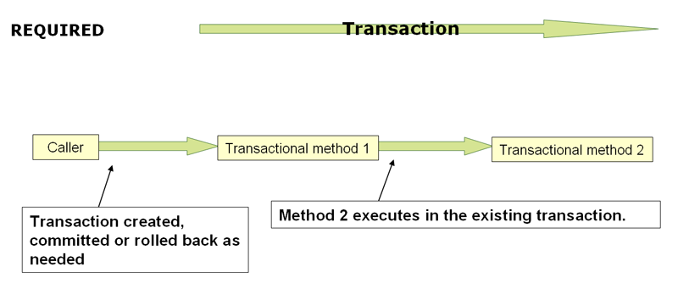
17.5.7 Transaction propagation

Slide 115
When the propagation setting is PROPAGATION_REQUIRED,
a logical transaction scope is created for each method upon which the setting is applied.
Each such logical transaction scope can determine rollback-only status individually, with an outer transaction scope being logically independent from the inner transaction scope.
all these scopes will be mapped to the same physical transaction.
So a rollback-only marker set in the inner transaction scope does affect the outer transaction’s chance to actually commit (as you would expect it to).
However, in the case where an inner transaction scope sets the rollback-only marker, the outer transaction has not decided on the rollback itself
A corresponding UnexpectedRollbackException is thrown at that point.
The outer caller needs to receive an UnexpectedRollbackException to indicate clearly that a rollback was performed instead.

Slide 116
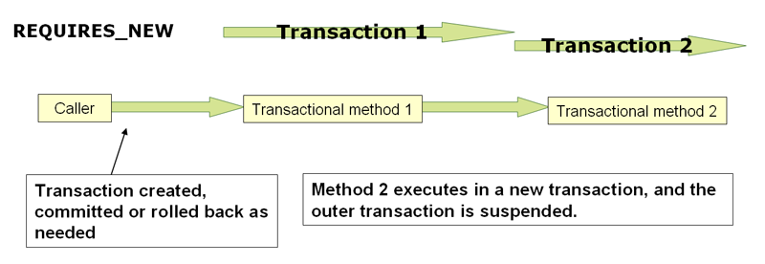
PROPAGATION_REQUIRES_NEW
always uses an independent physical transaction for each affected transaction scope, never participating in an existing transaction for an outer scope.
In such an arrangement, the underlying resource transactions are different and hence can commit or roll back independently, with an outer transaction not affected by an inner transaction’s rollback status.

Slide 117
Nested
PROPAGATION_NESTED uses a single physical transaction with multiple savepoints that it can roll back to.
Such partial rollbacks allow an inner transaction scope to trigger a rollback for its scope, with the outer transaction being able to continue the physical transaction despite some operations having been rolled back.
This setting is typically mapped onto JDBC savepoints, so will only work with JDBC resource transactions.

Slide 118
18. DAO support
18.2 Consistent exception hierarchy
Spring provides a convenient translation from technology-specific exceptions like SQLException to its own exception class hierarchy with the DataAccessException as the root exception.
These exceptions wrap the original exception so there is never any risk that one might lose any information as to what might have gone wrong.
In addition to JDBC exceptions, Spring can also wrap Hibernate-specific exceptions, converting them to a set of focused runtime exceptions (the same is true for JDO and JPA exceptions).
This allows one to handle most persistence exceptions, which are non-recoverable, only in the appropriate layers, without having annoying boilerplate catch-and-throw blocks and exception declarations in one’s DAOs. (One can still trap and handle exceptions anywhere one needs to though.)
As mentioned above, JDBC exceptions (including database-specific dialects) are also converted to the same hierarchy, meaning that one can perform some operations with JDBC within a consistent programming model.

Slide 119
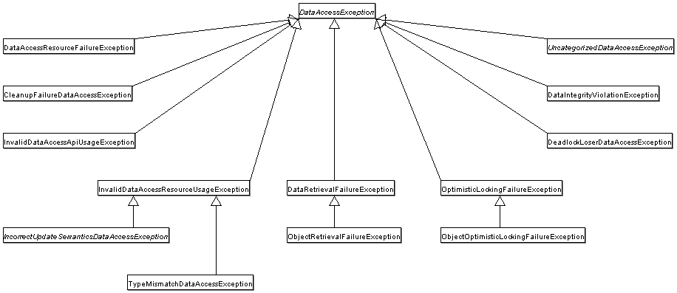

Slide 120
18.3 Annotations used for configuring DAO or Repository classes
The best way to guarantee that your Data Access Objects (DAOs) or repositories provide exception translation is to use the @Repository annotation.
allows the component scanning support to find and configure your DAOs and repositories without having to provide XML configuration entries for them.
@Repository
public class SomeMovieFinder implements MovieFinder {
// ...
}

Slide 121
Any DAO or repository implementation will need to access to a persistence resource, depending on the persistence technology used;
Here is an example for a JPA repository:
@Repository
public class JpaMovieFinder implements MovieFinder {
@PersistenceContext
private EntityManager entityManager;
// ...
}

Slide 122
references
Hibernate ORM 5.3.7.Final User Guide
http://docs.jboss.org/hibernate/orm/5.3/userguide/html_single/Hibernate_User_Guide.html
JPA Tutorial
https://www.tutorialspoint.com/jpa/index.htm
JPA Tutorial
https://www.javatpoint.com/jpa-tutorial
A Guide to JPA with Spring
https://www.baeldung.com/the-persistence-layer-with-spring-and-jpa
Spring Framework reference
https://docs.spring.io/spring/docs/4.3.x/spring-framework-reference/html/index.html

